Slide 1

NCERT|
National Council of Educational
Research and Training
CLASS X (CYCLE -2) National Achievement Survey (NAS)

Slide 2
Sampling
NAS BACKGROUND

Slide 3
NAS Class X (Cycle 2) Objectives
To study the achievement levels of students of Class X from government, government-aided and private schools in the subjects–English, Mathematics, Science, Social Science and Modern Indian Language (MIL)
To study the difference in achievement levels with regards to area, gender, social group, board and management of schools
To study the effect of intervening variables like students’ home background, school and teacher on achievement levels of students
To compare the performance of students in all subjects from Cycle-1 to Cycle-2

Slide 4
Overview of Class X NAS Cycle 2
Dimensions | In the Previous Cycle | Current NAS 2018
Parameters of Student testing | Common core curriculum | Competency based questions
Methodology | State as a sampling unit | District as a sampling unit
Timelines | 3 year cycle | Complete within the session District level results to come by March end
Survey Outcomes | State and National Reports | District level feedback for designing quality enhancement interventions

Slide 5
NAS | Key Features (1/2)
Students of all 36 States and Districts of India will be tested
DATE OF ASSESSMENT IS 5 FEBRUARY 2018
Random sample was taken from ALL the schools in the country having secondary classes (Class X) and recognized by State Education Boards or National Boards of Education CBSE and ICSE
A sample of 80 schools per district from each State/ Board is sampled
A maximum of 45 students from each sampled school will be included in the main survey

Slide 6
NAS | Key Features (2/2)
)
Grade | Subjects Tested | Number of Questions | Nature of Assessment
X | English, MIL, Mathematics, Science, Social Sciences | In each subject, questions are organized in 3 booklets Each booklet includes 60 questions | Formal Multiple Choice Questions
Note: In English and MIL, focus is on testing reading comprehension only

Slide 7
NAS | Different Phases of Class X NAS
1. Development, QA and finalization of survey tools
2. Drawing of Samples
3. Training of State, District and MIS Coordinators
4. Printing of survey tools at State Level
5. Dispatch of survey tools to schools
6. Day of Assessment
7. Data capturing and reporting for analysis
8. Generation of District Level Reports
9. Development of state and national reports
10. Development of intervention plans

Slide 8
Sampling
ROLES AND RESPONSIBILITIES

Slide 9
National Level
Department of School Education & Literacy, MHRD
ESD, NCERT
National Level

Slide 10



Roles And Responsibilities: Department of School Education and Literacy, MHRD (1/2)
Facilitation of survey activities across the country both at the national and state levels
Continuous monitoring of progress of NAS activities
Providing financial support through grant-in-aid, as approved by the PAB-RMSA
Notes:
Reference : Google images

Slide 11

Roles And Responsibilities: Department of School Education and Literacy, MHRD (2/2)
Ensure coordination between various stakeholders in all NAS activities
Notes:
Reference : Google images

Slide 12
Roles And Responsibilities: NCERT (1/4)
Plan and coordinate all major activities related to the survey
Periodically apprise State/Board officers and Institutional Coordinators (ICs) for monitoring and facilitating all survey activities
Develop, quality assure and disseminate various survey related documents such as – Technical Standards, Assessment Framework, Sampling Framework, Translation Guidelines, Financial Norms etc.

Slide 13
Roles And Responsibilities: NCERT (2/4)
Develop guidelines for survey activities
Organize training programmes for ICs and SLMTs
Provide soft copy of survey material to States/ UTs Boards – achievement tests, questionnaires, OMR sheets
Develop data entry and data analysis plan and reporting frameworks for generating stakeholder specific reports

Slide 14
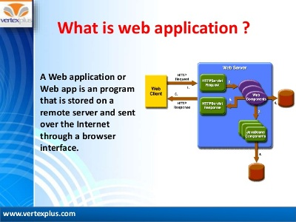
Roles And Responsibilities: NCERT (3/4)
Develop a NAS Class X web application for data uploading and generation of automated District Report Cards (DRCs)
Allocate funds for conducting the survey activities in States/UTs as per norms approved by NCERT

Slide 15
Roles And Responsibilities: NCERT (4/4)
Prepare schedule of the main survey activities for States/UTs
Monitor, supervise and facilitate the activities of the survey
Ensure availability of ESD expertise at State Level (ICs) for consultation and resolution of issues during the survey
Provide guidance for the collection of filled- in survey material
Develop National and State Reports

Slide 16
State Level
Chairperson of State/National Education Board/Director SCERT/ Senior Officer from the Senior Education Office is the State Coordinator
Institutional Coordinator and Associate Institutional Coordinator are nominated by the State Coordinator
State Project Director – RMSA and one Monitoring Assistant at SPD-RMSA office

Slide 17


Roles And Responsibilities: State Coordinator (1/3)
Implement survey activities in all the districts of the State/UT in coordination with the State Project Director (SPD) – RMSA
Provide:
Guidance in conducting the survey
Support (i.e. basic office facilities) to the IC in conducting the survey
Act as a liaison officer between NCERT and IC

Slide 18

Roles And Responsibilities: State Coordinator (2/3)
Nominate one
District Education Officer (DEO) as District Coordinator (DC) in all the districts of the State/UT for implementing survey activities at the school level. The DC also has to coordinate the scanning, verification and upload of CSV files into the NAS Class X web application and DRC generation
Assistant District Coordinator (ADC) at district level for assisting DC
MIS Coordinator to carry out data scanning, verification, uploading CSV files into the NAS Class X web application for generation of District Report Cards

Slide 19
Roles And Responsibilities: State Coordinator (3/3)
Facilitate IC for attending meetings/ programmes associated with the survey and for ensuring smooth functioning of all survey activities

Slide 20
Roles and Responsibilities: Institutional
Coordinator (IC) and Associate IC (1/6)
Provide the following lists to the NCERT
Names and contact details of the State Coordinator, ICs and Associate ICs, District Coordinators (DC), Associate District Coordinators and MIS Coordinators
List of all schools having class X in the format prescribed by NCERT
Provide the following list to DC
List of sampled schools for verifying the class X medium(s) of instruction as well as the number of the students in class X/sections

Slide 21
Roles and Responsibilities: Institutional
Coordinator (IC) and Associate IC (2/6)
Facilitate districts in the procurement and setting up of the scanning device as well as the scanning software.
The scanner and software will be used to capture data from OMR sheets and this activity will be completed with the help of the MIS Coordinators
If the State/UT have already setup the devices for scanning of OMR sheets in NAS Classes III, V and VIII under SSA, then, States/UTs HAVE to use the same setup for NAS Class X (Cycle 2).

Slide 22
Roles and Responsibilities: Institutional
Coordinator (IC) and Associate IC (3/6)
Organize a workshop for translation, vetting and finalization of achievement tests from source language i.e. Hindi/English into their regional language counterparts for the main survey
Process: This activity will need to be carried out with the help of subject experts
Outcome: This activity will end with the State/UT sharing soft copies of achievement tests with fonts, images and relevant links to NCERT at ncertnas10@gmail.com

Slide 23
Role and Responsibilities: Institutional
Coordinator (IC) and Associate IC (4/6)
Organize training program with the help of SLMTs for DCs in conduct of the survey activities
Ensure that the verified lists of sampled schools are received from the District Coordinators within 7 days of receipt at district level and same are emailed to the NCERT at ncertnas10@gmail.com
Disburse funds as per NCERT norms to DCs for conducting the survey in sampled schools
Update the status of NAS activities on trackers provided by NCERT

Slide 24
Criterial for Selection of Replacement Schools
Criterial for Selection of Replacement Schools
Every sampled school in the list is supplemented with two replacement schools (replacement 1 and replacement 2).
If original sample school is not in a situation (i.e. school has collapsed due to natural disasters) to conduct the assessment, then the District Coordinator proceed to conduct the assessment in replacement school 1 and if the replacement school 1 is also in similar situation then the replacement school 2 may be selected and the same is to be documented to NCERT.
However, the replacement should not exceed more than 15% in a district.
Although the desired student sample size per school is 45, if the number of students in the sampled section is less than 45, the FI should test all the students.

Slide 25
Criterial for Selection of Replacement Schools
Criterial for Selection of Replacement Schools
At the time of verification of list of sampled schools by the District Coordinator, if a sampled school is found to have enrolment of less than 15 students in Class X, then the DC should consider replacement school as per procedure mentioned in point number-2. Such situations have to be documented and permission to do the same, needs to be sought from the NCERT.
If FI found zero presence in a sampled school on the day of test administration then FI should record the information in Field Notes and same is to be submitted to District Coordinator with proper reason.
No replacement of schools will be permitted on the day of test administration.
Combining of sections for administration of test is not permitted.

Slide 26
Role and Responsibilities: Institutional
Coordinator (IC) and Associate IC (5/6)
Monitor the activities of the survey
Medium wise printing and packaging of survey material as per the sampled lists
OMRs should be packed separately in a poly-pack and thereafter in a corrugated box
Distribute the printed and packaged survey material to District Coordinators on the day of their training in sealed packets.
A packet of one school contains following survey material:

Slide 27
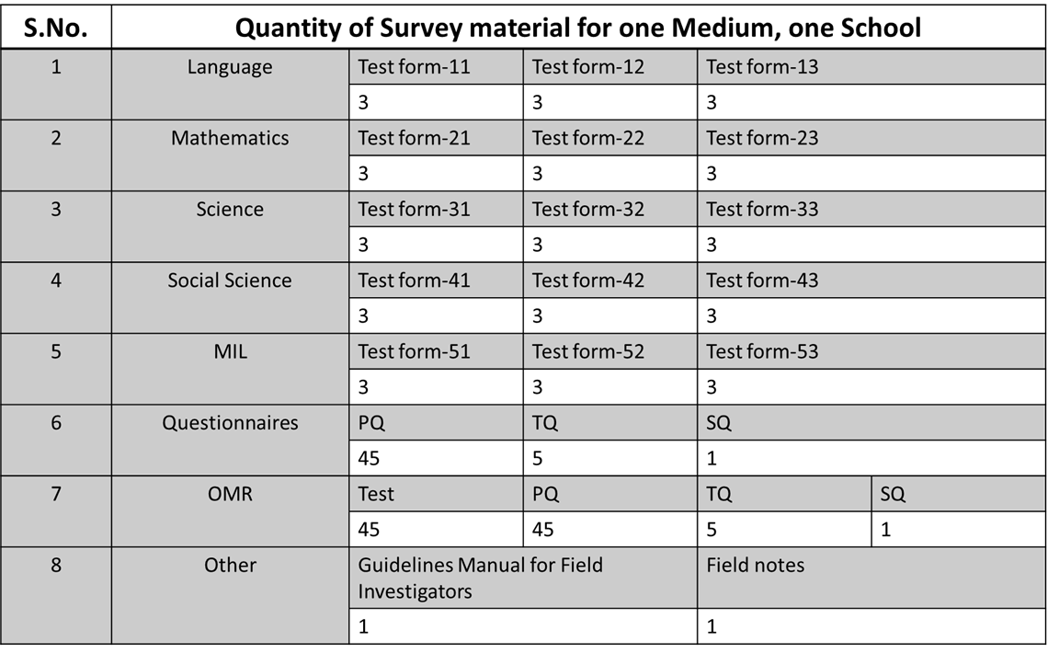
Role and Responsibilities: Institutional
Coordinator (IC) and Associate IC (6/6)
Note:
(i) Add EXTRA copies: Test OMRs – 5 PQ – 2; PQ-OMRs – 5.
(ii) While planning for printing of tests, ensure that only one medium for one school is to be considered (consider medium, which has maximum enrollment in Class X of sampled school).

Slide 28
Key Points to be followed during District Coordinators’ Training (1/2)
Explain the roles and functions of relevant teams, especially for DCs and Field Investigators (FIs) at school level
Explain the different procedures of administering the survey– e.g. filling of forms and codes, selection process of section & students etc
Share the training schedule of FIs, day of survey administration, required quantity of survey material with DCs etc
Update the status of NAS activities in Progress Module of NAS X Web Application
Ensure that all students of Class X should be present on 5 February 2018

Slide 29
Key Points to be followed during District Coordinators’ Training (2/3)
Coordinate with DCs with reference to the following:-
- Different procedures and activities of the survey
- Confidentiality of the test material at different stages
- Submission of bills & vouchers in original
- Statement of expenditure with unspent balance (if any)
Check with the DCs that the FIs have returned used and unused survey material after the administration of tools
- The same has been duly counted and scrutinized by the District Coordinator

Slide 30
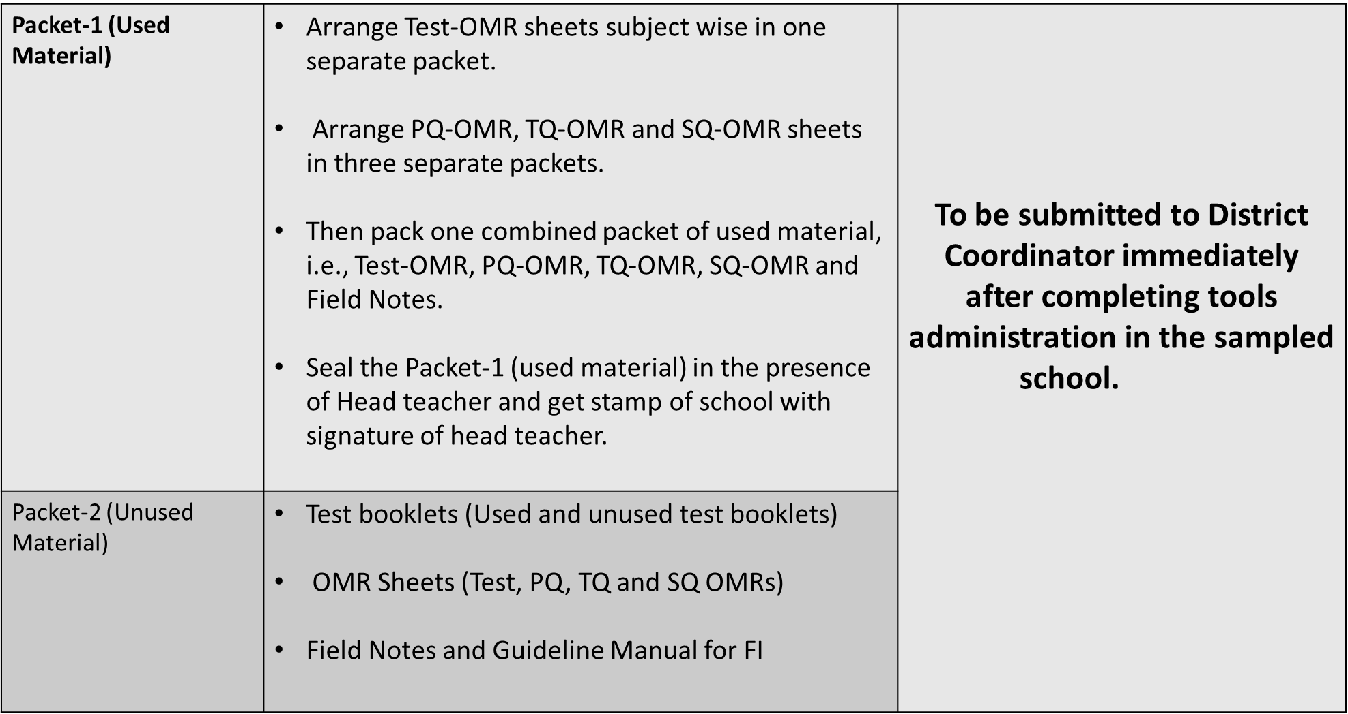
Key Points to be followed during District Coordinators’ Training (3/3)
Explain collection procedure of used and unused survey material from each sampled school as below:
Packing List

Slide 31
Roles and Responsibilities: RMSA - SPD
Nominate one Monitoring Assistant at SPD-RMSA office for day-to-day NAS X (Cycle 2) activities in the State/UT in coordination with State Coordinator
Constitute a team of observers for monitoring the test administration in 10-15 sampled schools in each district.
Provide detailed contact list of RMSA- DCs
1
2
3

Slide 32
District Level
DC and Assistant District Coordinator
MIS Coordinator
District Level

Slide 33
Role and Responsibilities: District Coordinator (DC) and Assistant DC (1/6)
Attend training programmes at State/UT level conducted by IC
Verify the existence of sampled schools, medium(s) of instruction in Class X in the school and number of students in the sampled school with the school’s UDISE code and report discrepancy, if any, within 7 days, to IC (in the format provided by IC). Apart from this verify the list of CBSE & ICSCE sampled schools in your district.
Identify two FIs for each sampled school in the district and convey the same to the IC

Slide 34
Role and Responsibilities: District Coordinator (DC) and Assistant DC (2/6)
Provide contact details of FIs to IC
Coordinate with IC and MIS Coordinator in set up of Scanning devices and software for capturing data from OMR sheets at district level
Communicate the day of test administration in all sampled schools to the School Head one week before the test date
Instruct the School Head to collect the survey material from the DC three working days prior to the conduction of the test

Slide 35
Role and Responsibilities: District Coordinator (DC) and Assistant DC (3/6)
Collect NCERT norms from IC for conducting main survey activities
At the district level, organize training workshop for the FIs one week before the test administration for conducting survey activities in the schools
Provide Guideline Manual for Field Investigators to FIs to carry out survey activities in the school

Slide 36
Role and Responsibilities: District Coordinator (DC) and Assistant DC (4/6)
Provide hands on experience (live demonstration of filling various dummy tools) to FIs during the training programme
Ensure that school wise sealed bundle prepared at state level containing the required NAS test material is safely handed over to Head of the Sampled Schools before 3 working days of the day of the test administration
Receive back filled-in survey material from FIs of sampled schools as per Packing List shown in Guideline Manual

Slide 37
Role and Responsibilities: District Coordinator (DC) and Assistant DC (5/6)
The FI must submit the Survey material immediately after tool administration to DC
After receiving data, verification team in coordination with MIS Coordinator needs to perform a quality check: verify entries in each and every OMR of ATs, PQs, TQs and SQs with Field Notes of every sampled school
Collect bills & vouchers in original along with consolidated statement of expenditure duly signed by the Head of the sampled school

Slide 38
Role and Responsibilities: District Coordinator (DC) and Assistant DC (6/6)
Reimburse travelling expenditure (TA) made (at actual as per NCERT norms) at school level to FI immediately after submission of filled in survey material at DC office and its verification
Send the detailed expenditure statement with original bills & vouchers and a brief report about conduct of survey activities to the IC
Update the status of NAS activities on NAS X Web Application

Slide 39
Key Points to be followed during FI Training (1/2)
Explain clearly, activities of FI as described in the section of School Level Roles & Responsibilities of FIs
Provide printed copy of duly signed letter of introduction to each FI
Explain procedure for selection of a section and students (if required) in the selected school
Provide Guideline Manual for Field Investigators to FIs
1
2
3
4

Slide 40
Key Points to be followed during FI Training (2/2)
Provide hands on experience on various activities e.g. Sitting plan, distribution of tests & administration, filling up of FNs, OMR sheets & Questionnaires
Explain procedure for selection of a section and students (if required) in the selected school
Explain about packaging as per packing list shown in Guideline Manual and forwarding
5
6
7

Slide 41
Roles and Responsibilities: MIS Coordinator
(1/4)
Attend the district level training on the NAS Web Application/ data capturing software
Ensure availability of an operational ADF OMR scanner in office
Ensure that OMR sheets design provided by NCERT must be adhered to
Follow the ‘.csv’ template available on the NAS Class X Web Application. Should ensure no changes are made to the format and the scanned data is submitted as per the format of ‘.csv’ template

Slide 42
Roles and Responsibilities: MIS Coordinator
(2/4)
Manage the scanning of achievement test and questionnaire OMR sheets separately
MIS team to physically cross check each and every OMR sheet with the Field Notes after receiving filled in data from schools. In case if even one of the OMR data is found incorrect then DC and informed FIs to be informed immediately
Ensure that information of students' enrollment, presence and participation should be available in Field Notes and same is be uploaded on NAS Class X Web Application

Slide 43
Roles and Responsibilities: MIS Coordinator
(3/4)
MIS team to ensure that the Codes (e.g. Student ID) must be the same in OMRs of Achievement Test and PQ as allotted in Field Notes for every sampled student
After verification of OMR sheets with physical sheets of achievement Tests and Field Notes (Hard copy), upload the ‘.csv’ file pertaining to achievement tests on NAS Class X Web Application (Refer NAS Class X Web Application Manual)
Ensure that the final ‘.csv’ files (in district and school wise folders) of Achievement tests, PQ, TQ and SQ of all sampled schools in DVDs/CDs (after completion of uploading process) are sent to the State Coordinator

Slide 44
Roles and Responsibilities: MIS Coordinator
(4/4)
Please follow instructions given in the Guideline Manual and Data Capturing Manual for the entire process from designing of OMR sheets to uploading the ‘.csv’ files
Cross check completion of all tasks as specified in Guideline Manual
Preserve scanned images of Achievement tests, PQ, TQ and SQ and Field Notes of all sampled schools in DVDs/CDs at district level for next six months for future reference (These images may be required at NCERT level for analysis purpose)

Slide 45
Quality checks after receiving data from FIs
Receive data from the Field Investigators
Arrange and make lots –School wise
Organize data in small batches, i.e., Test-OMR, PQ-OMR, TQ-OMR, SQ-OMR
Check that all codes are filled properly in Test-OMR, PQ-OMR, TQ-OMR and SQ-OMR, if not verify codes from Field Notes and fill up properly in consultation with MIS Coordinator (Please do not alter/fill/refill responses given by students, teachers, Head teacher for questions asked).
Check that Test-OMR of a sampled school is in equal number to PQ-OMR and ensure that Student ID must be the same on Test-OMR and PQ-OMR for each student and must match with the Sheet-II of Field Notes.
Provide data capturing plan to data capturing agency (provided by NCERT).

Slide 46
Who can be a Field Investigator (FI)
The Field Investigator should preferably be a primary school teacher from any recognized schools at district level. If the states have less number of primary teachers as per requirement in the district, then the remaining FIs can be obtained from elementary schools. FIs must be identified other than sampled schools. (In case of non-availability of primary and upper primary teachers, State/UT may engage B.Ed./D.Ed. students.)

Slide 47
Roles and Responsibilities: Field Investigators
Pre Survey
Attend training programme organized by DC
Collect guideline manual for FIs from DCs
Collect letter of introduction from DC for visiting the sampled school
Get UDISE code, contact details and address of the sampled school to be visited

Slide 48
Overview of FI Responsibilities: During Survey
Get ready (before assembly) with Survey material received from Head of the School
Select Section if required
Select Students if Required
Ensure that all entries should be filled on OMR Sheet, test form and Field Notes as mentioned in Guideline Manual
Ensure that same Test Form should be distributed to students as allotted in of FN
Administer Achievement Test, PQ, SQ and TQ

Slide 49
Classroom Activities of FI (1/2)
Given below are specific tasks to be completed by FIs–
Read out instructions and examples for the students from the test booklet before test administration.
Explain to sampled students about filling codes on OMR sheets one by one using blackboard.
Explain them that answers are to be given by darkening circle of the option in the OMR sheet.
Blackboard may be used to explain the method of answering.
Ask students to raise his/her hand, if there is any question regarding directions.
Give sufficient time to complete the test.
Ensure that Codes on OMR Sheet and SHEET-II of Field Notes must be the same.

Slide 50
Classroom Activities of FI (2/2)
Given below are specific tasks to be completed by FIs–
After completion of test administration, immediately distribute one Pupil Questionnaire (PQ) with PQ-OMR to each student before leaving the class (every selected student has to fill PQ).
Ensure that student ID on Test-OMR and PQ-OMR should be the same as mentioned in Sheet-II of Field Notes (As PQ data is to be linked with his/her achievement data).
Make sure to collect the Test Booklets, Test-OMR, PQ and PQ-OMR from all the students before they leave the class.

Slide 51
Post Survey Activities (1/2)
Cross check all entries are made correctly and properly on all OMR Sheets and Field Notes
Fill Teacher questionnaire (TQ) for each subject teacher who is teaching to selected section
Fill School Questionnaire (SQ) with the help of Principal/Head Teacher
The FI must submit the Survey material (used and unused) immediately after test administration.
Both packets have to be handed over to the DC with actual expenditure statement with original bills & vouchers
Collect payment after submission of survey material from DC/ADC

Slide 52
Packaging Procedure (2/2)
Packet-1 (Used Material) | Arrange Test-OMR sheets subject wise in one separate packet Arrange PQ-OMR, TQ-OMR and SQ-OMR sheets in three separate packets Then pack one combined packet of used material, i.e., Test-OMR, PQ-OMR, TQ-OMR, SQ-OMR and Field Notes. Seal the Packet-1 (used material) in the presence of Head teacher and get stamp of school with signature of head teacher | To be submitted to District Coordinator immediately after completing tools administration in the sampled school.
Packet-2 (Unused Material) | Test booklets (Used and unused test booklets) OMR Sheets (Test, PQ, TQ and SQ OMRs) Field Notes and Guideline Manual for FI
To be kept safely at District Level by DCs for at least next six months

Slide 53
Sampling
SAMPLING

Slide 54
NAS School Level Sampling: Section and Student (1/14)
FI will carry out both section and student sampling on the day of the assessment prior to test conduction (if needed)
Section Sampling
Student Sampling
NAS X
School Level Sampling

Slide 55

Note (2/14)
Section sampling needs to be done ONLY and ONLY if there are more than one section of class X in the sampled school.
Combining of sections is not permissible
Student sampling needs to be done only if there are more than 45 students in the sampled section/class.

Slide 56
Random Selection of Section: Key Processes (3/14)
Fill the first 4 columns of the Table given below. The table is appended in the Field Notes of the guidelines document
S. No. of Section | Section Name | Medium of Instruction | Number of Students Enrolled | Number of Students Present on the Day of the Assessment | Selected Section (√ Mark)
1 | A | Kannada | 48 | 46 | B
2 | B | English | 54 | 53
3 | C | English | 52 | 52
Total Students |  |  |  |  | 54
Column needs to be filled after selecting the section

Slide 57
Random Selection of Section: Key Processes (4/14)
Refer to the sampled school’s UDISE Code (e.g. given below)
Add together, digits of the district code (two digits) and the digits of the school code (two digits)
Write down the result
In our example, district code is ‘12’ and school code ‘13’. Add digits of the district code to the digits of the school code
Final result is = 1 + 2 + 1 + 3 =
0 | 1 | 1 | 2 | 0 | 3 | 1 | 2 | 3 | 1 | 3
State Code |  | District Code |  | Block Code |  | Village Code |  |  | School Code
7
Important to Note

Slide 58
Random Selection of Section: Key Processes (5/14)
Write down the serial number of the sections in a line - as shown in the following figure:
In the current example, we are assuming that the sampled school has 3 sections: 1, 2 and 3
Starting from section ‘1’, move to the next sections, counting ONE section at a time, in a cyclical fashion (as shown in the given picture)
1
2
3
Step-1
Step-2
1
2
3
Step-3

Slide 59
Random Selection of Section: Key Processes (6/14)
Continue counting and moving till you get to the number calculated in step 3 (which in our example is 7)
The section to be selected in the current example will be 2 or B
Step-4
Step-5
1
2
3
Step - 6
Selected Section
Step-7
1
2
3

Slide 60
Overview of the Student Selection Process (7/14)
Fill and complete
Sheet I
Calculate the Sampling Interval (SI)
Select the first student by calculating the Random Start (RS) number
Select other students in the sample by adding RS to SI
Repeat the process till 45 students are selected
Fill and complete Sheet II

Slide 61
Student Sampling: Key Steps (8/14)
Conditions for Selection of the Students
If the selected school has presence less than 15 students in the class on the day of survey then survey is to be conducted in that school communicate the same to DC/ADC immediately.
If the selected school has minimum 15 and not more than 45 students in the class then take all of them.
If there are more than 45 students in the selected section in a Class, then select only 45 students as per procedure.

Slide 62
Student Sampling: Key Steps (9/14)
List all the students of the sampled section/class, as per the school register in Sheet-I in Field Notes. (If the total number of students in the Class/selected section, is more than 45 then use additional sheet).
S.No | Name of the Student | Gender | Category | Allot Student ID
1
2
3
4

Slide 63
Student Sampling: Key Steps (10/14)
Calculate the Sampling Interval (SI) either by using a formula or the Table of SI. Both the formula and table are given below :-
45
Example 1: Suppose the total enrolment in the sampled section/class in the school is 78, then SI will be 2
SI = 78 = 1.73 (rounded to 2)
45
Example 2: Suppose the total enrollment in the sampled section/class in the school is 54, then SI will be 1
SI = 54 = 1.20 (rounded to 1)
45
SI = Total number of students enrolled in the sampled section/class in the school

Slide 64
Student Sampling: Key Steps (11/14)
                Table of SI
If the numerical value after the decimal in the SI is more than 0.50, then the SI value needs to be rounded off to the next whole number (refer to previous slide).
If the numerical value after the decimal in the SI is less than 0.50, then the SI value needs to be rounded off to the preceding whole number (refer to previous slide).
For selecting the first student, use the Random Start (RS) method. Explanation of the method is given in the next slide:-
Number of Students in the Sampled Section/ Class in the school | 46-67 | 68 - 112 | 113 – 157
Sampling Interval | 1 | 2 | 3

Slide 65
Student Sampling: Key Steps (12/14)
  Calculate the random start number by adding together digits of the district and the school code (as done in step 3 of section sampling)
(e.g.) If the District and school codes(taken from the UDISE code) are 12 and 13 respectively, then the Random Start (RS) number will be 7 (1+2+1+3)
Use the Random Start number which has been generated to select the first student. The student needs to be selected from the serially arranged students’ list created by the FI in Step 1. For the example given above, student mentioned at serial number 7 in sheet I will be selected.
Other students will be selected as per the following method:-
  Student 1 - RS
  Student 2 - RS+SI
  Student 3 - RS+2SI
  Student 4 - RS+3SI; and so on...

Slide 66
Student Sampling: Key Steps (13/14)
If SI is 2, then the selected students would be at serial number 7, 9, 11, 13,15….
Students | RS | SI | Student Selected
Student 2 | 7 | 2 | 7 + 2 = 9
Student 3 | 7 | 2 | 7 + 2*2 = 11
Student 4 | 7 | 2 | 7 + 2*3 = 13
Student 5 | 7 | 2 | 7 + 2*4 = 15
If you get to the end of the list of students (sheet I) before getting 45 students, continue your counting from the beginning of the student list again, until the sample of 45 students has been selected.
If the name of a student already selected in the sample gets repeated for inclusion in the sample, do not choose this student. Select the immediate next student and continue your counting, until the sample of 45 students has been selected.

Slide 67
Student Sampling: Key Steps (14/14)
Transfer information for all selected students from Sheet I to Sheet II and fill all the columns in Sheet II e.g. roll no, students’ names, gender, category etc.
Sheet II
Student ID Allotted | Name of the Student | Attendance | Gender | Category | CWSN | Test Form No
01 | Rajni | A | F | GEN |  | 11
02 | Suresh | A | M | SC |  | 21
03 | Iqbal | A | M | ST | VI | 31
04 | Radha | A | F | SC |  | 41
05 | Anuj | A | M | SC |  | 51
06 | Ketan | A | M | GEN |  | 12
07 | Karun | A | M | SC |  | 22

Slide 68
Sampling
TEST CONDUCTION

Slide 69
Session I (Administration of Tests and PQ)
Carryout survey activities as explained in Guideline Manual for FIs Select section (if required)
Select students (if required)
Fill up of Field Notes (Sheet-I & Sheet-II).
Make sitting arrangement as per seating plan
Distribute tests and Test-OMR as per Sheet-II of Field Notes.
Explain necessary codes and other information in OMR sheets to sampled students
Distribute PQ and PQ-OMR immediately after completion of test administration
Check that Test-OMR must be in equal number to PQ-OMR and ensure that Student ID should be same on Test-OMR and PQ-OMR for each student and must match with the Sheet-II of Field Notes.

Slide 70
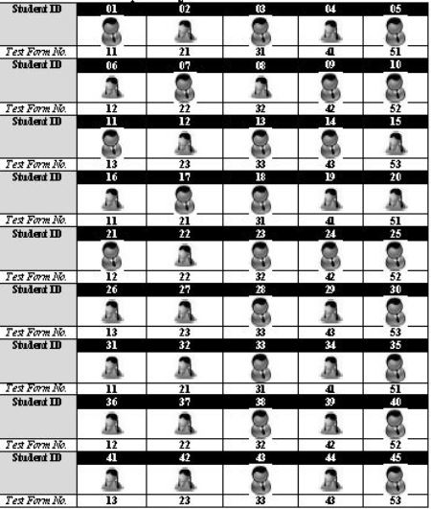
Sitting & Distribution of Test Form Plan

Slide 71
Session II (TQ, SQ and Remaining Work)
Filling up of Teacher Questionnaire with subject teachers teaching to sampled students and School Questionnaire with Head of the School.
Arrange Test-OMR sheets subject wise in one separate packet.
Arrange PQ-OMR, TQ-OMR and SQ-OMR sheets in three separate packets.
Pack one packet for used material i.e., Test-OMR, PQ-OMR, TQ-OMR, SQ-OMR and Field Notes.
Seal the packet number one (used material) in the presence of Head teacher and get stamp of school with signature of head teacher.
Pack second packet for all unused material.
Complete remaining task if any
THE TOTAL WORK IS TO BE COMPLETED IN THE SCHOOL ON THE SAME DAY i.e. ON THE DAY OF TEST ADMINISTRATION -5February 2017

Slide 72

Working with Codes: FI Roles and Responsibilities (1/2)
Ensure that all entries should be filled on OMR Sheet, test form and Field Notes as mentioned in Guideline Manual.
Below is an example of filling different codes:
UDISE Code: Use 11 digit UDISE school code
Student ID: Allotted by FI in Sheet-I of Field Notes against each selected student and thereafter, transferred into Sheet-II, Student ID wise serially arranged, i.e. 01-45
Test form Code: Ex.: Code for Test form 1 (booklet 1) of Mathematics
Medium Code: In which test to be administered e.g. code for English
2 | 1
1 | 3

Slide 73
Working with Codes: FI Roles and Responsibilities (2/2)
Children With Special Needs (CWSN)
School to facilitate children with disabilities in following manner:
30 minutes extra time will be given to complete the test.
Facility of scribe or amanuensis will be given to the students.
Resource teacher should be consulted for conducting the test.
It should be ensured that suitable adaptations are made according to the child's needs.
Types of disabilities:
LD - Locomotor Disability
VI - Visual Impairment
HI - Hearing Impairment
S&LD - Speech & Language Disability
ID - Intellectual Disability
OthD - Other Disability

Slide 74
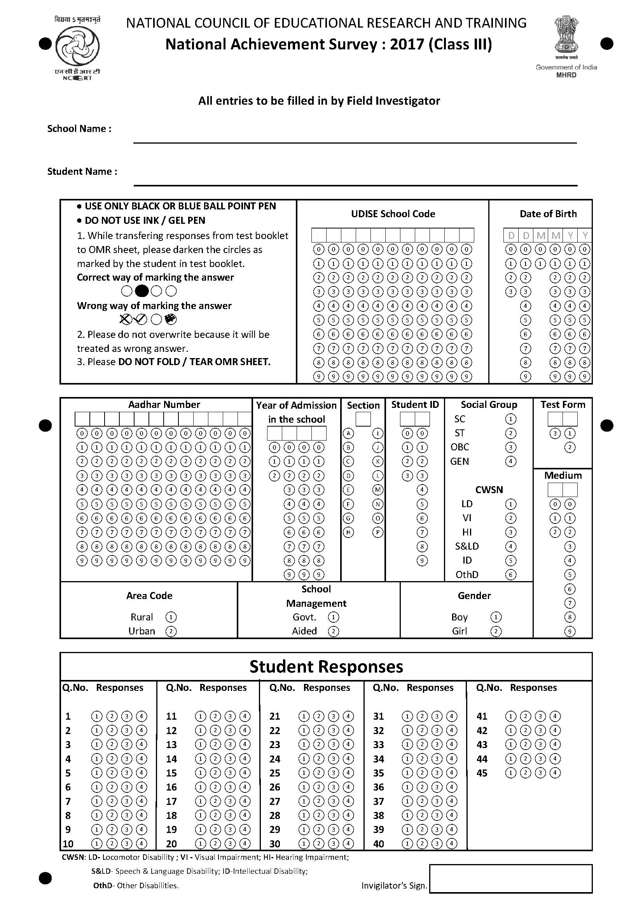
OMR Use (1/2)
How to use OMR Sheets? Distribute one Test-OMR sheet to each student along with test booklet Instruct students to use CAPITAL LETTERS of English ONLY, wherever required (Use of regional language should be prohibited!) Explain to students how to mark their responses on the OMR sheet Ask students to use ball point pen ONLY (Black or Blue) for filling up the OMR sheets

Slide 75
OMR Use (2/2)
How to use OMR Sheets? (Contd.) The FI will have to ensure that all the codes have been filled properly in the Test-OMR sheets and Field Notes. The FI should explain each entry one by one to sampled students using blackboard before administration of tests in the school. Explain to students that NO OVERWRITING OR CORRECTION is allowed after darkening the circle against each entry. Ensure that OMR sheet should not be folded or crushed, keep the sheets neat and clean.

